Slide 1

ESCAPE ROOM MINI-PROJECT 1
Louis Ampobi
Ivan Jimenez Palomino
João Sousa
Ryan van den Akker

Slide 2
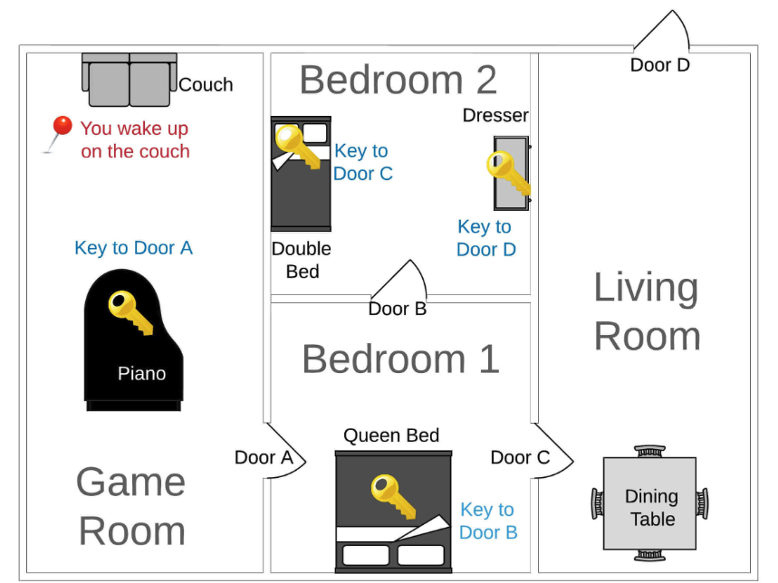

Project Overview
GAME’S STRUCTURE:
Lists = [ all_rooms, all_doors]
Dictionaries = {furniture, door, key, room, outside} / {object_relation, game_state}
Notes:
How is the game’s structure organized?
Which functions do you have and how are they imported?
Which features did you add to the game?

Slide 3

Project Overview
GAME’S STRUCTURE:
Functions:
def start_game(): Locate the player in the initial position and trigger the game
def play_room(): Examine if the player is in target room, if not gives the options (Explore or Examine).
def explore_room(): Gives a descriptions of items and the location.
def get_next_room_of_door(): Analyze the 2 rooms of the door and send the player to the one he is not in.
def examine_item: Depending of the item will add keys to player inventory list or interact with doors to trigger the get_next_room_of_door.
Notes:
How is the game’s structure organized?
Which functions do you have and how are they imported?
Which features did you add to the game?

Slide 4
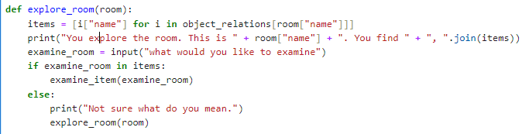
Project Overview
Functions improvement :
Def explore_room()
Conditional loop in the explore function and prevent the wrong answers:
Notes:
How is the game’s structure organized?
Which functions do you have and how are they imported?
Which features did you add to the game?

Slide 5

Technical Challenge
What was the most important technical challenge you faced?
Modifications of functions which are included in other functions
How did you overcome that challenge?
Understanding the purpose of each one of the functions in each other

Slide 6

Technical Challenge
What was the most important technical challenge you faced?
Import of the function to an external files and then import then back to the Jupyter notebook file.
How did you overcome that challenge?
By creating both folders in a local directory

Slide 7

Big Mistake
What was the biggest mistake you made during this project?
Introduce validation input to avoid errors
What did you learn from it?
To understand the function first and plan how to integrate all its aspects instead of do the code and then improvise

Slide 8

Demo Slide
Link to your project: https://colab.research.google.com/drive/1DmJPs8yUjABNb9YYaAkS_im9io4ooUQU?usp=sharing
DEMO

Slide 9

Congratulations, you escaped!
Project Name: Quest: Escape Room
Presented by: Louis Ampobi, Ryan van den Akker, Ivan Jimenez, João Sousa
Thank You!

Slide 10
Thank you for your time and attention 🙂

